Slide 1
Title of the project “RANKING SYSTEM OF TOP 98 FOOTBALL TEAMS IN EUROPE’S TOP 5 LEAGUES & TOP 100 STRIKERS OF THE LEAGUES OF THE YEAR 2017/2018”
Objective
Determining the best team and best striker in European top 5 league of the year 2017-18

Slide 2
summary
The object of this research was to develop a rating system for all the clubs based on matches played, won, drawn, lost, goal scored, goals conceded, goal difference and points earned, and for the top 100 forward players/forwards based on the number of goals scored and assist provided by a player, in a particular season of football in Europe's top 5 leagues. The websites, Kaggle and Transfermarkt served as the sources for required data. Firstly, we devised a unique formula based on our subjective assessment of the game and the individual performances of the players. This was done with the help of analytic hierarchy process, otherwise known as AHP rating.
Principal Component Analysis is widely used in applied multivariate data analysis, and this article shows how to motivate student interest in this topic using football sports data. Here, principal component analysis is successfully used to rank all the clubs and top 100 forwards in the 2017/18 season of football in Europe's top 5 leagues. In particular, the principal component is seen to explain a substantial portion of the variation in a linear combination of some commonly used measures of football prowess.This application provides an excellent, elementary introduction to the topic of principal component analysis. The results thus revealed prove to be satisfactory and useful for those who intend to indulge further on the subject.

Slide 3
Methodology
Z score Method
PCA Method
Rating Formula for Clubs:
[{3*(Goal Difference)}+{2*(Points Won)}] /(Matches Played)
Rating Formula for Strikers:
[{(Goals)+(Assists)}*(Goals)] /[Matches Played]
Rating Formula for Clubs (in PCA):
Played*(0.011) + Win*(0.421) + Draw*(-0.057)
+ Lost*(-0.406) + Goals for*(0.394) + Goal against*
(-0.360) + Goal Difference*(0.430) +
Points*(0.428)
Rating Formula for Strikers (in PCA):
Matches*(-0.311) + Goals*( 0.710) +
Assists*(0.632)

Slide 4
Analysis
From the Pie chart we can conclude that almost every league has same amount of contribution in total combined goals in top 5 league except “Bundesliga” because in this league total number of teams is 18 rather than 20.
From the Bar chart we can conclude that almost every league has same amount of contribution in total combined goals in top 5 league except “Bundesliga”because in this league total number of teams is 18 rather than 20.but the average goals scored is almost same as other leagues.

Slide 5
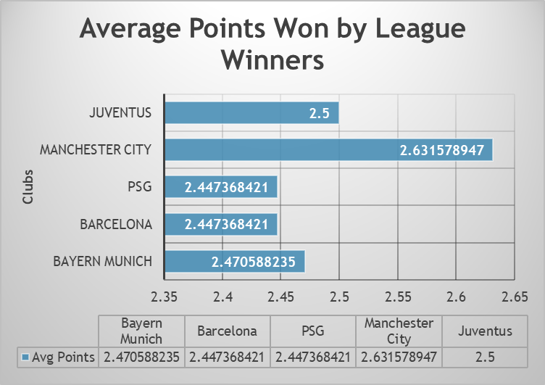
Comparative study between league winning clubs
Between the winners of each league of European Top 5 league “Manchester City” has higher avg points which is comparatively more than any other league winning clubs

Slide 6
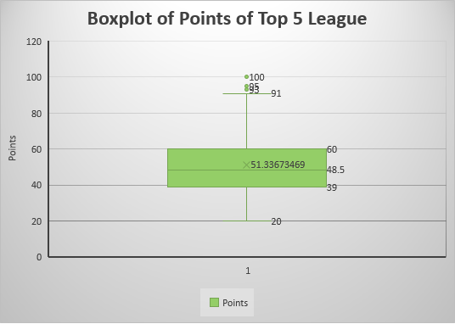
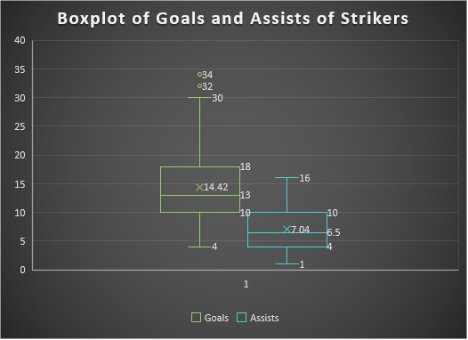
Boxplot for clubs’ and strikers data analysis
From the boxplot we can observe that the median,1st quartile,3rd quartile,mean,upper range and lower range are 48.5,39,60,51.33,91 and 20 respectively. There are three outliers 93,95 and 100
From the first boxplot we can observe that the median,1st quartile,3rd quartile,mean,upper range and lower range are 13,10,18,14.42,30 and 4 respectively.There are two outliers 32,34. From the second boxplot we can observe that the median,1st quartile,3rd quartile,mean,upper range and lower range are 6.5,4,10,7.04,16 and 1.

Slide 7
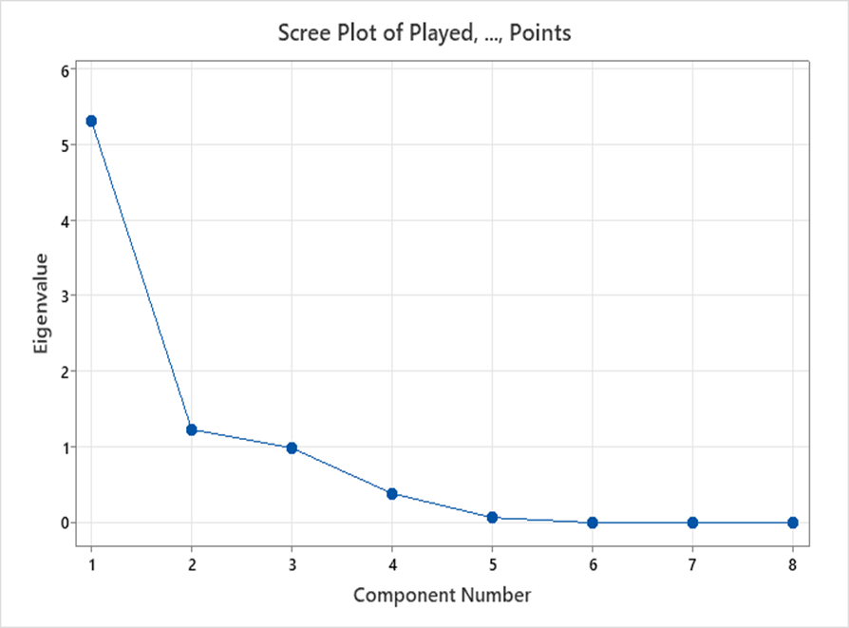
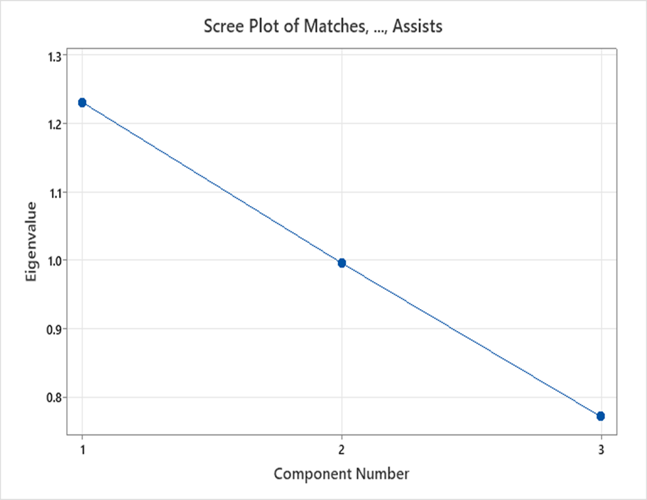
Screeplot of pca analysis
Screeplot for clubs’ data PCA Analysis
Screeplot for Strikers’ data PCA Analysis

Slide 8
Tables obtained after ranking acoording to z score and pca score
From this table we can coclude that “Manchester City” is the best team in the year 2017-18
From this table we can conclude that “Lionel Messi” is the best player in the year 2017-18

Slide 9
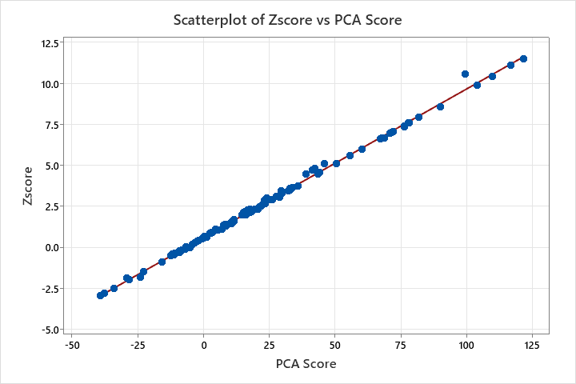
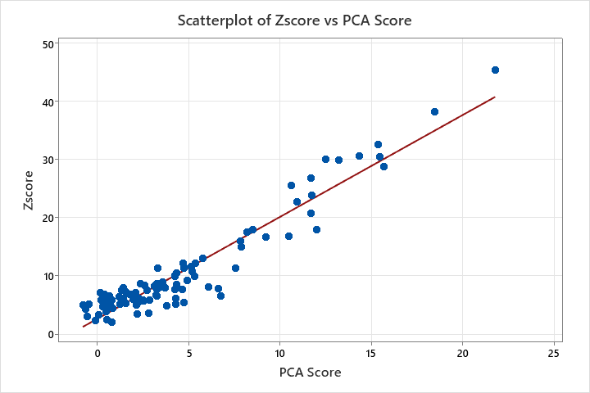
Comparison between z score and pca score
From this above stated Scatterplot, it is evident that the Z-Score of the top 100 European Football Clubs using the given data of matches played, won, lost, drawn, goals scored, goals conceded, goal difference and points won that has been calculated using the formula is positively and quite strongly correlated with the PCA Scores, which has been calculated from the very first set of eigen values in the Principal Component Ananlysis
From this above stated Scatterplot, it is evident that the Z-Score of the top 100 Strikers in Top 5 European Leagues using the given data of matches played,goals scored, assists provided that has been calculated using the formula is positively and quite strongly correlated with the PCA Scores, which has been calculated from the set of eigen values in the Principal Component Ananlysis.In other words, it refers to that our self-made statistic is quite efficient in the analysis to rank the top 100 Strikers in Top 5 European Leagues.

Slide 10
reference
Sources of Theory:-
Principal Component Analysis,Second Edition by I.T.Jolliffe
Aspects of Multivariate Statistical Theory by ROBB J.MUIRHEAD
http://www.journalijar.com/article/17892/principal-component-analysis-as-a-ranking-tool---a-case-of-world-universities./
Software used :-
Rstudio
Minitab 21 Statistical Software
Microsoft Excel 2016
Microsoft Word 2016

